Slide 1
Introduction to rwrfhydro
Arezoo Rafieei Nasab
6/7/2018
WRF-Hydro training, June 2018

Slide 2
Data ingest

Slide 3
GeoSpatial related function

Slide 4
Precipitation evaluation

Slide 5
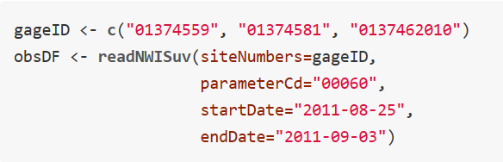
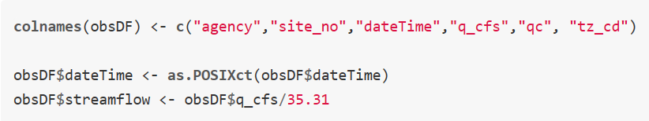
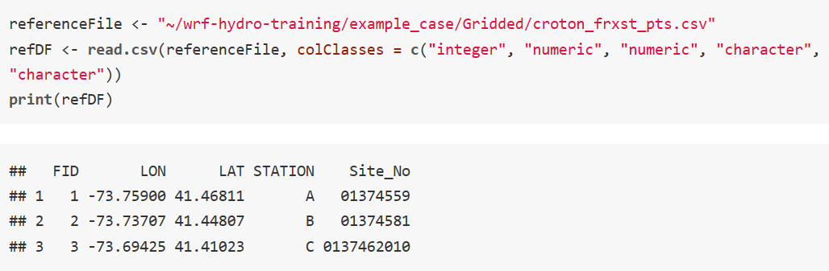
Streamflow Evaluation
Download USGS streamflow data using dataRetrieval library
How to make the connection between feature_id (in frxst_pts_out.txt and CHANOBS file) and the gage ID?
This part is required only for Gridded and NCAR reach based routing
Add feature_id (FID) to the observation data

Slide 6
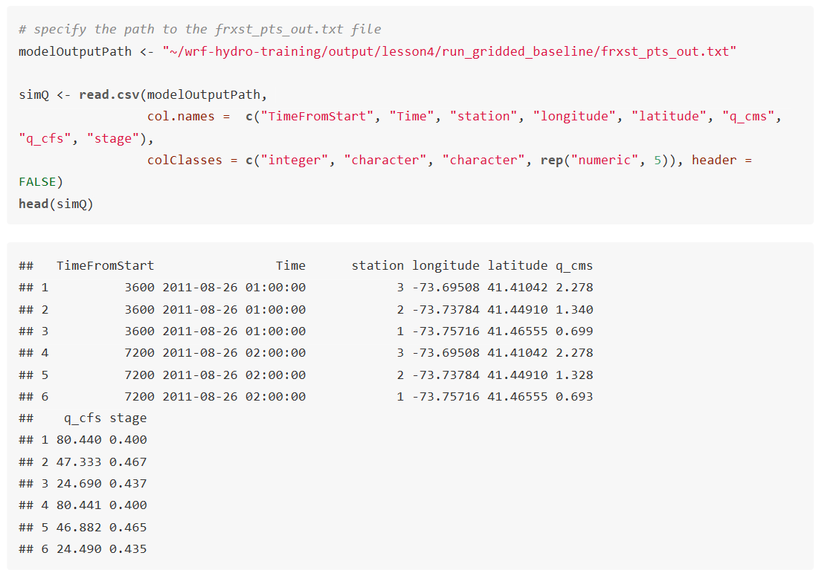
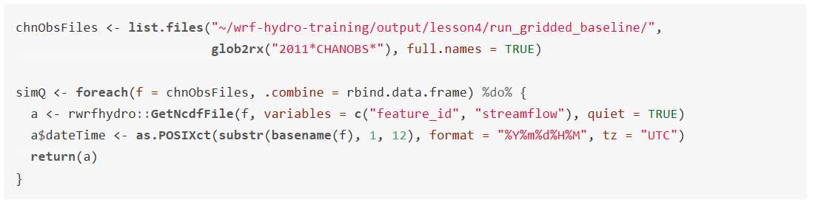
Streamflow Evaluation
Read the frxst_pts_out.txt file
Read the CHANOBS files

Slide 7
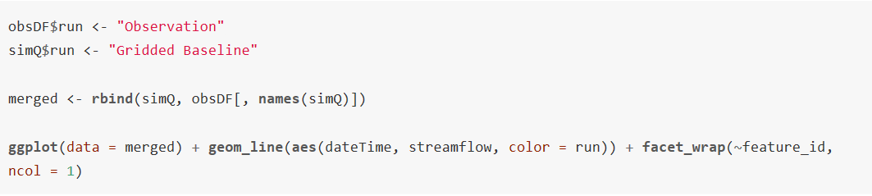
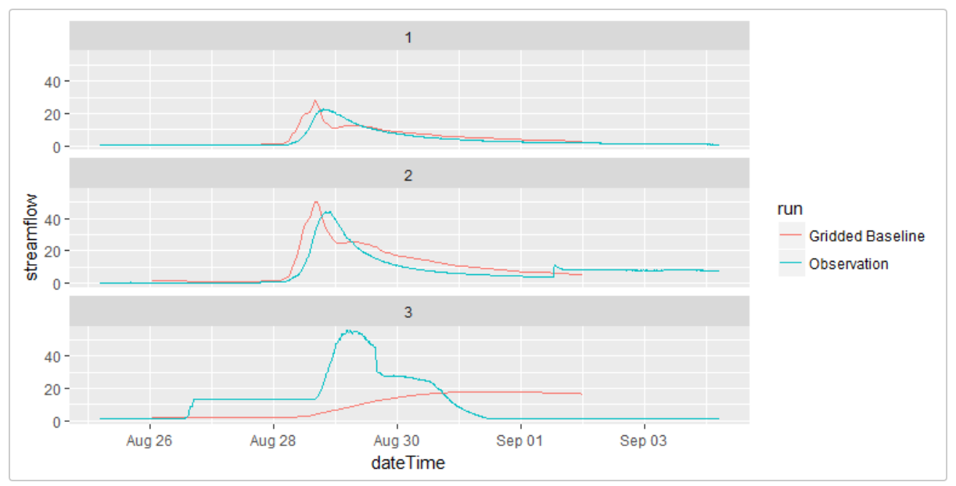
Streamflow Evaluation

Slide 8
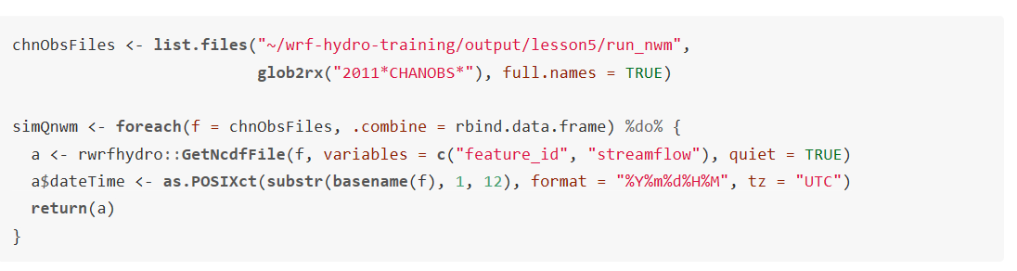
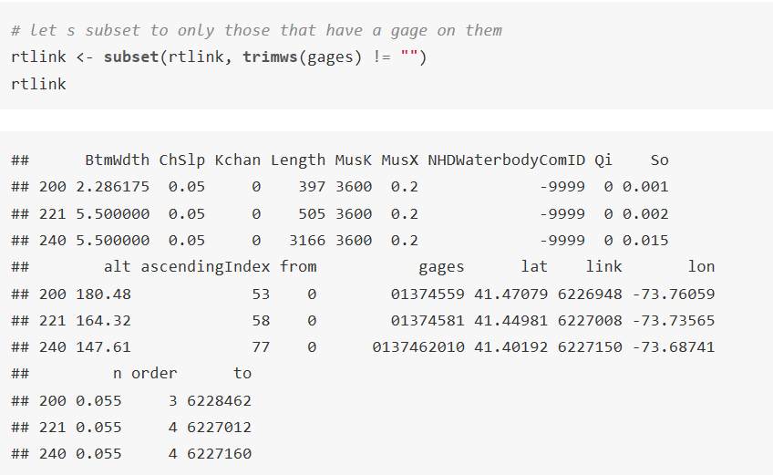
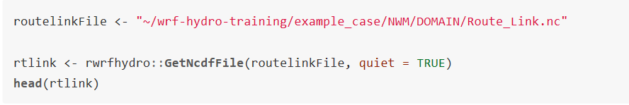
Streamflow Evaluation
Let s read the CHANOBS files for the NWM run
How to make the connection between the feature_id in the CHANOBS and gage ID

Slide 9
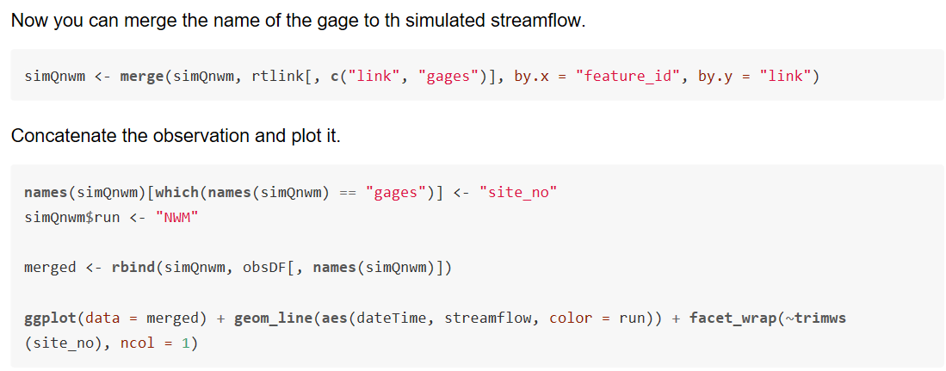
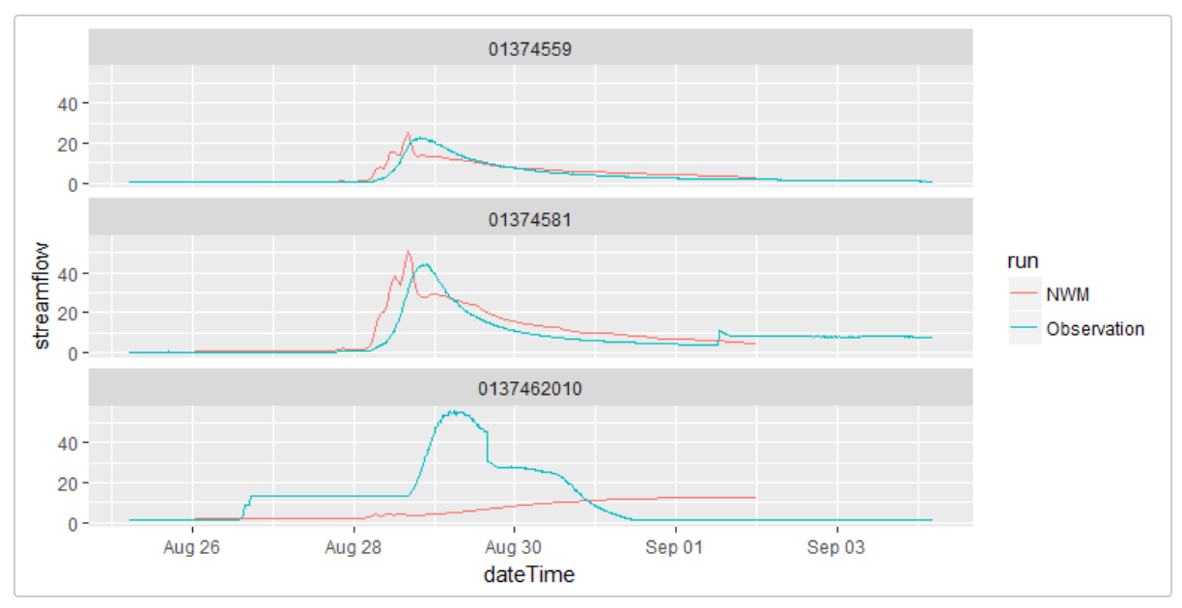
Streamflow Evaluation

